Slide 1
Comparison of Artificial Intelligence systems for the detection of objects on UAV-based images
Technical UNIVERSITY OF CRETE
SCHOOL OF ELECTRICAL AND COMPUTERS ENGINEERING
Trimas christos

Slide 2
Outline
What are UAVs?
Why Object Detection?
Motivation
Theoretical Background
RetinaNet
Modified Version of RetinaNet (A Two-Phase approach)
Conclusions
Limitations and Future Work

Slide 3
What are UAVs?
Why Object Detection?
Motivation
Theoretical Background
RetinaNet
Modified Version of RetinaNet (A Two-Phase approach)
Conclusions
Limitations and Future Work

Slide 4
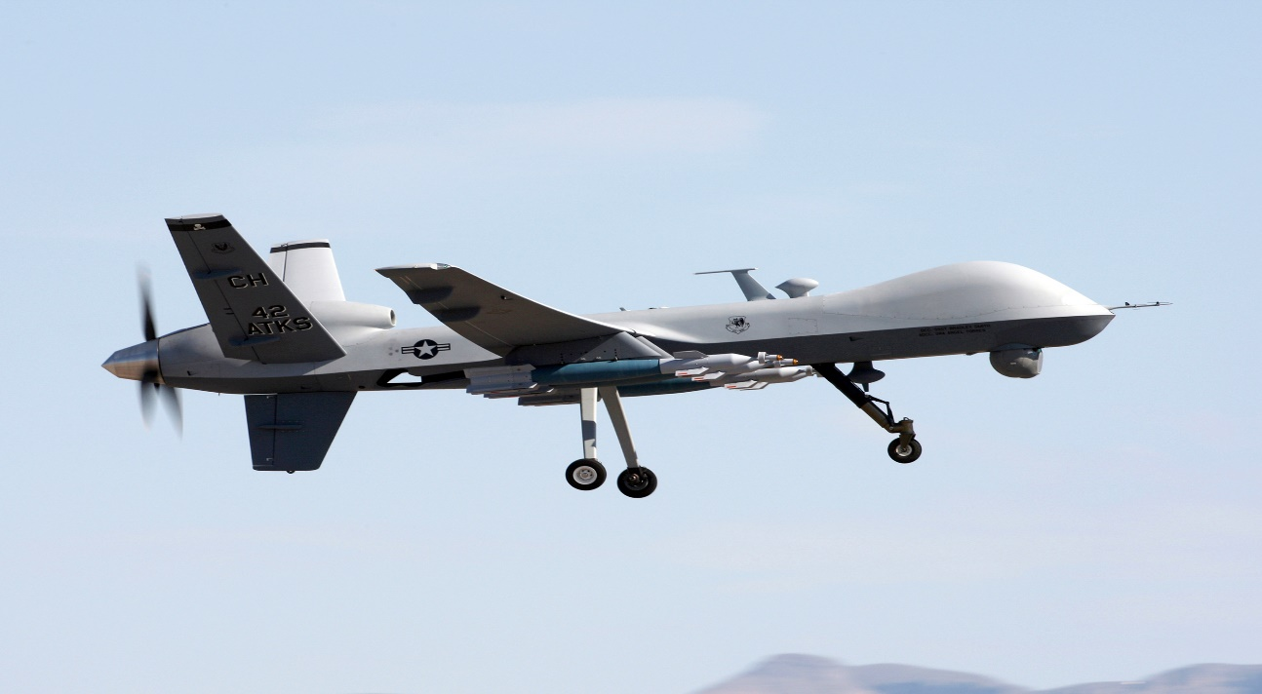
UAVs
Unmanned Aerial Vehicles:
Search and Rescue missions
Surveillance
Information gathering
Object Detection

Slide 5
What are UAVs?
Why Object Detection?
Motivation
Theoretical Background
RetinaNet
Modified Version of RetinaNet (A Two-Phase approach)
Conclusions
Limitations and Future Work

Slide 6
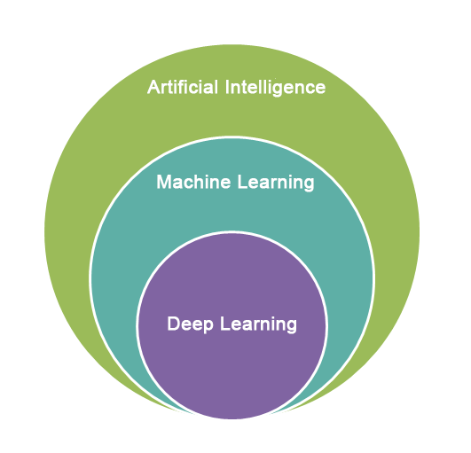
Object Detection
Evolution of Object detection
Better electronics = better cameras
Artificial Intelligence
Data Revolution
Higher Computational Power

Slide 7
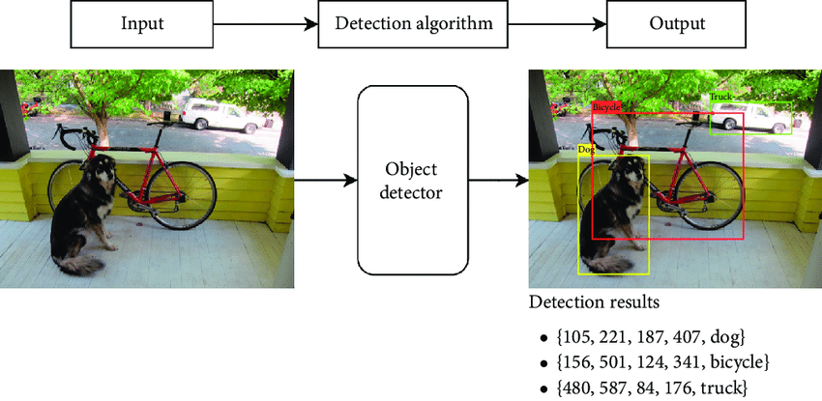
Object Detection
General Idea: Object detection = localization + classification.

Slide 8
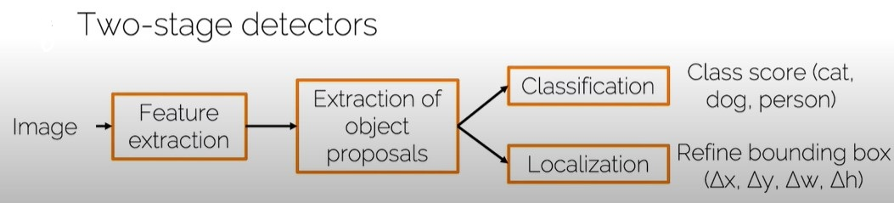
Object Detection Systems
Two-stage pipelines:
First Stage generates sparse set of candidate proposals
Second Stage classifies the proposals into classes
Tuned for Accuracy
R-CNN, Fast R-CNN, Faster R-CNN

Slide 9
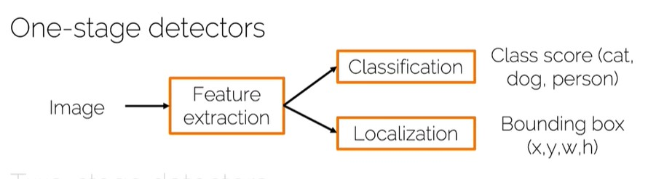
Object Detection Systems
Single-stage pipelines:
Single pass through the network
Predicts all the bounding boxes in one go
Tuned for Speed
YOLO, RetinaNet

Slide 10
What are UAVs?
Why Object Detection?
Motivation
Theoretical Background
RetinaNet
Modified Version of RetinaNet (A Two-Phase approach)
Conclusions
Limitations and Future Work

Slide 11
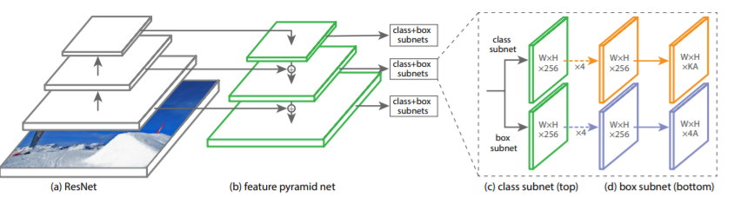
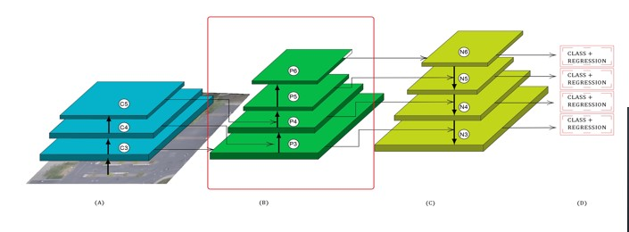
Motivation
RetinaNet
Sophisticated Loss-Function
Simple Architecture from other CNNs
Two-phase FPN RetinaNet
Introduction of an extra Convolution Block in FPN
Higher complexity and depth

Slide 12
What are UAVs?
Why Object Detection?
Motivation
Theoretical Background
RetinaNet
Modified Version of RetinaNet (A Two-Phase approach)
Conclusions
Limitations and Future Work

Slide 13
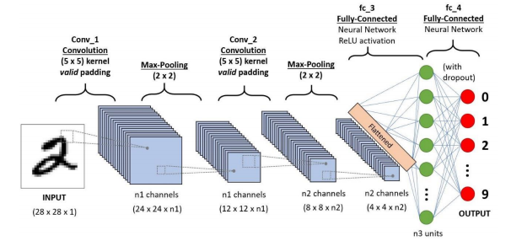
Convolution Neural Networks
Typical CNN:
Convolution layers
Max / Average Pooling layers
Fully Connected layers

Slide 14
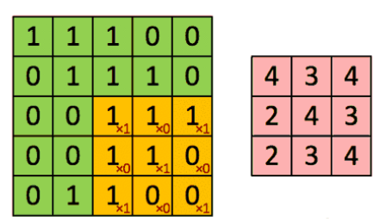
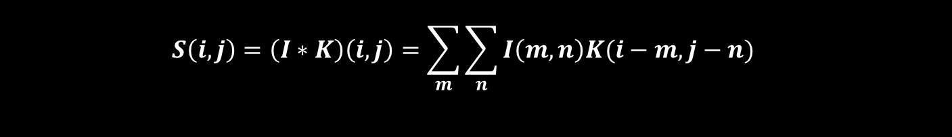
Convolution Layer
Goal: Extract high-level semantically rich
features from the input image
$$S\left(i,j\right)=\left(I∗K\right)\left(i,j\right)=\sum_{m}{\sum_{n}{I\left(m,n\right)K(i−m,j−n)}}$$

Slide 15
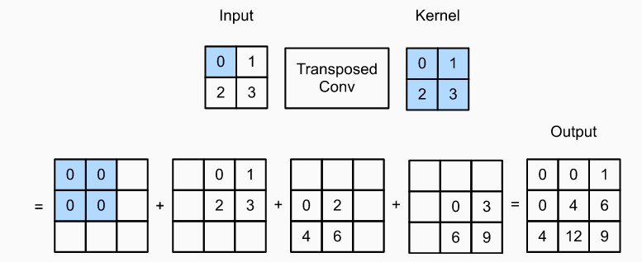
Transpose Convolution
Goal: to increase (up-sample) the spatial dimensions of the intermediate feature maps

Slide 16
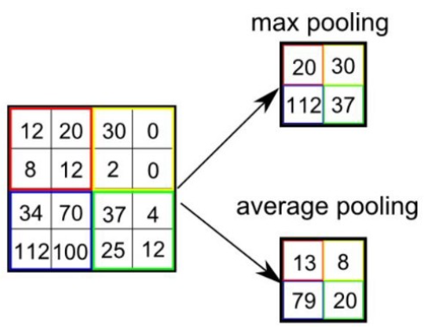
Pooling Layer
Goal:
Decrease computational power required to process data
Extract dominant features through dimensionality reduction

Slide 17
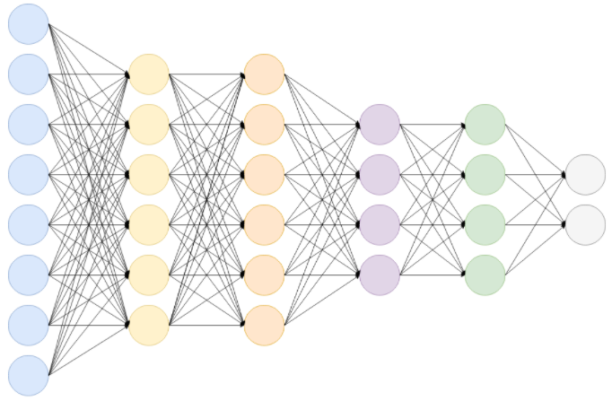
Fully Connected Layers
Final layer: gets the probabilities and
classifies each input into particular classes.
Cheap way of learning non-linear combinations of the high-level features
as represented by the output of the convolution and pooling layers.

Slide 18
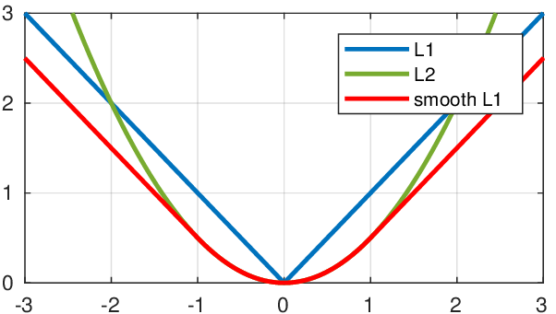
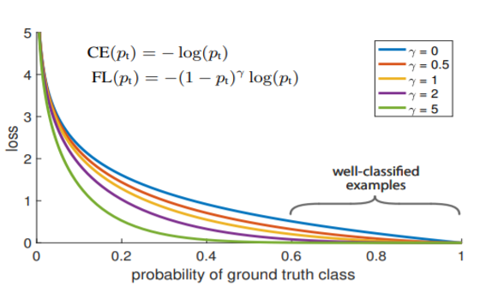
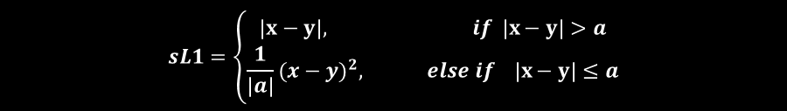
Loss Functions
Loss function : the prediction error of the Artificial Neural Network.
Responsible for the update of the weights of the Neural Network.
$$sL1=\left\{\begin{aligned}\left|x−y\right|, if \left|x−y\right|>a \\ {\frac{1}{\left|a\right|}(x−y)}^{2}, else if \left|x−y\right|≤a\end{aligned}\right.$$
$$FL\left(p_{t}\right)={\left(1−p_{t}\right)}^{γ}log(p_{t})$$

Slide 19
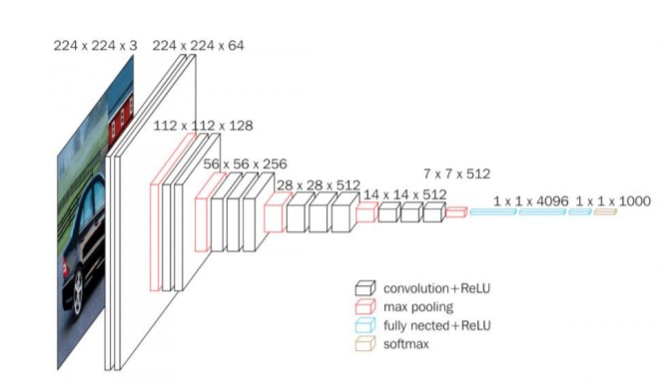
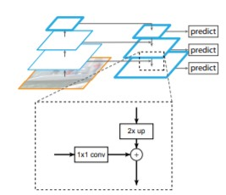
CNNs v Fully CNN
CNNs:
Contains Fully Connected Layers.
Can be used as backbone networks.
ResNet, VGG, etc.
Fully CNNs:
No Fully Connected Layers.
Performs only Convolution, up-sampling and down-sampling operations.
Can handle different input sizes.
Unet, Feature Pyramid Network, etc.

Slide 20
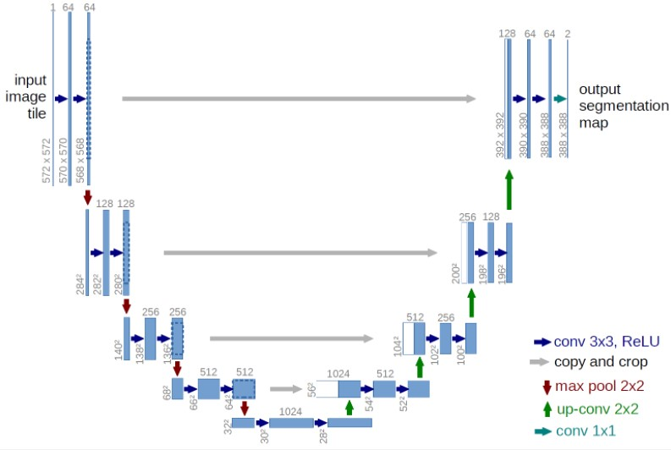
U-Net
Top-down pathway: Simple ConvNet consisting of convolutions and max pooling operations.
Bottom-up pathway: “Deconvolution” and convolution operations as well as concatenation to combine high level and low level features.

Slide 21
Feature Pyramid Network
Feature Pyramid Network can be used as backbone network for object detection or segmentation
Consists of an “encoder” (bottom-up pathway) and a “decoder” (top-down pathway)
Bottom-up pathway: Usually a ConvNet is used for feature extraction such as VGG or ResNet.
Using lateral connections the output of the ConvNet is fed to the top-down pathway as input.
Top-down pathway: Using up-sample to match the spatial dimensions between the output of two consecutive Convolutional Blocks it adds the outputs in order to create a rich multi scale convolutional pyramid.

Slide 22
FPN v U-Net
Main difference: FPN has multiple prediction layers, one for each upsampling layer.
Both architectures have lateral connections, but Unet only crops and copies the features, while the FPN applies a 1x1 convolution layer before adding them.

Slide 23
RCNN

